Slide 1
What is your opportunity? (for finding a good job)
Beneficial Bootstrap/ Pinwei Wu , (HELIA AGHABABAZADEH)

Slide 2
What is opportunity?
How many jobs can I apply for?
→ Total job numbers of each category
Can I work everywhere I want?
→ Total city numbers of each category
Can I make a lot of money?
→Average salary of each category

Slide 3
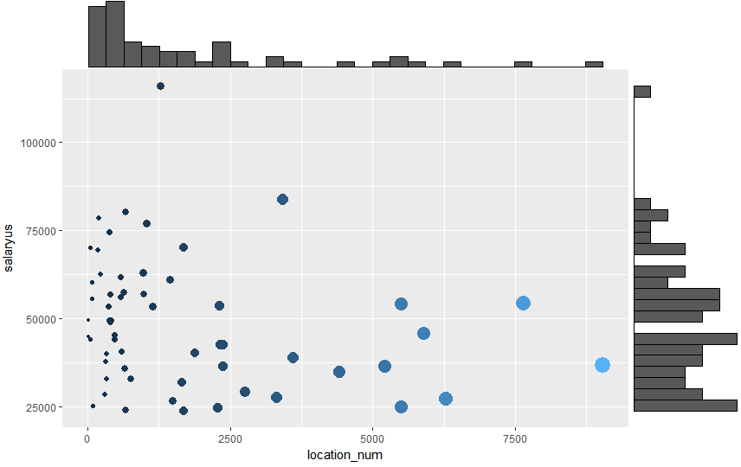
Size of dots: Total Job number
Total City number relate to
Total Job number
→ For categories which can work widely, there are more jobs.
More job categories distribute on the left corner.
→ Most of job categories are relatively low salary and less location flexibility.
Mean Salary(USD)
Total city number (counts)

Slide 4
Guess Who?
Size of dots: Total Job number
Mean Salary(USD)
Total city number (counts)

Slide 5
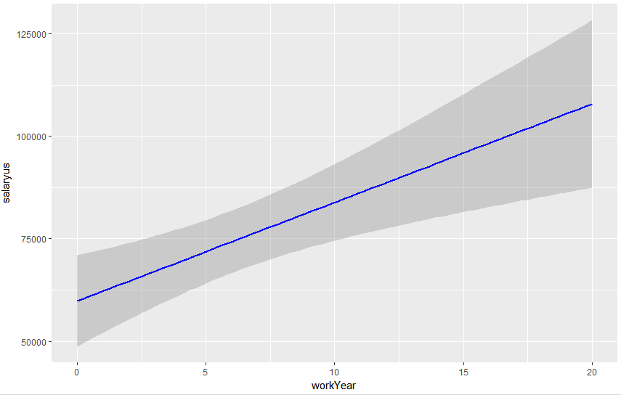
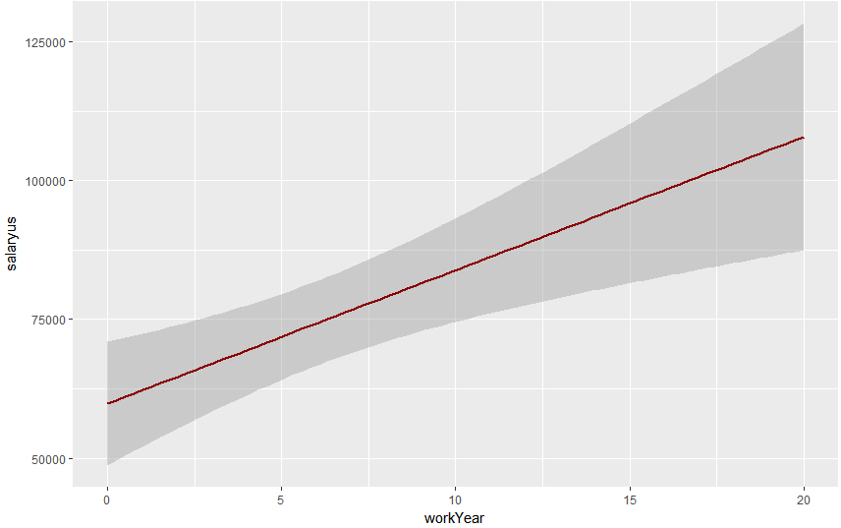
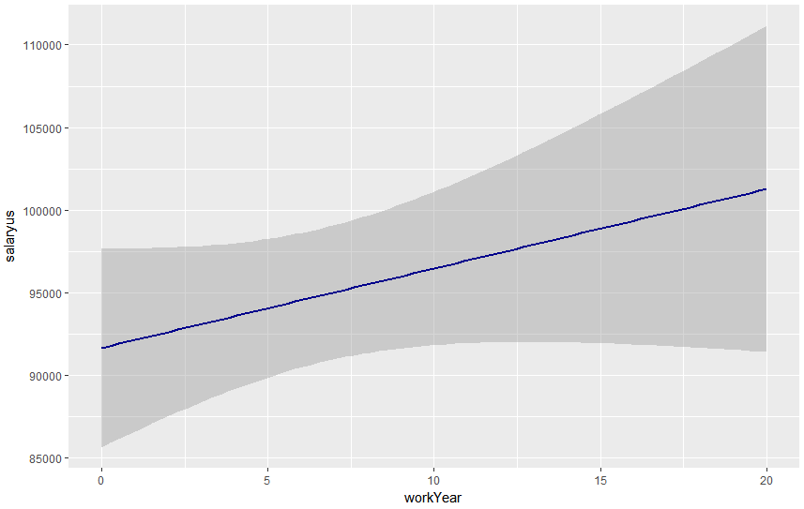
How is the salary growing?
Doctor(Meddr)
Tech software
Magnagement

